Slide 1
Agenda RAB Meeting #10
1. Welcome and Introductions
2. Adopt minutes of Meeting #9
3. Remedial Investigation (RI) Outline/Table of Contents
a. Schedule
b. Some Examples
4. Soil Vapor Extraction System Update
5. Other Technical Updates
6. Next meeting: Agenda, Date, and Location
7. Comments & Questions from the public
8. Adjourn

Slide 2
Draft Remedial Investigation Outline
Some Words About the RI
Heavily Referenced
Important Technical Aspects of the Phase III Work Discussed in Section 4 and 5
Conclusions Formulated in Human Health Risk Assessment in Section 7
RAB Review Roll Out during October Meeting

Slide 3
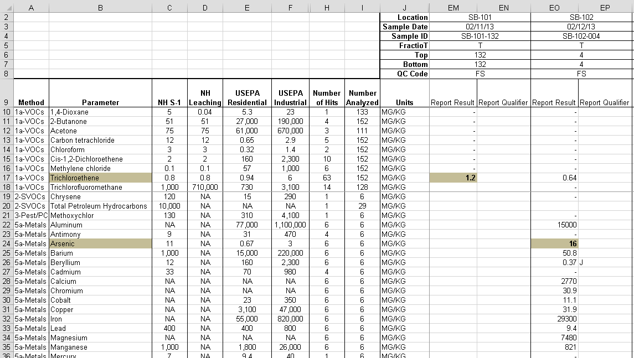
Example Table in RI

Slide 4
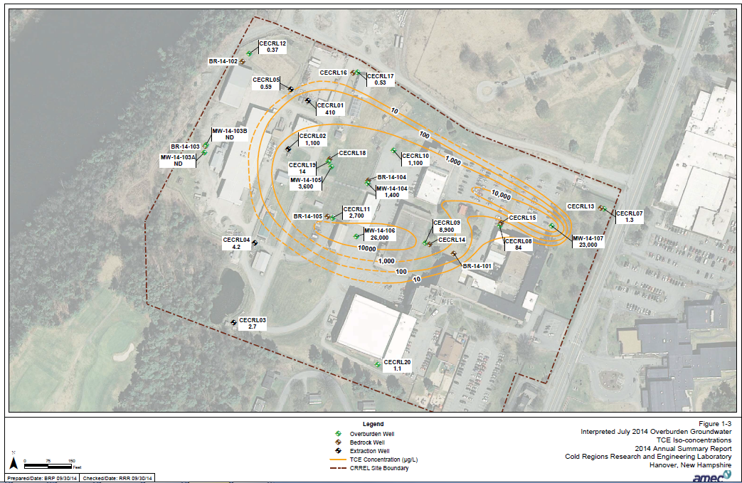
Example Interpretive Figure

Slide 5
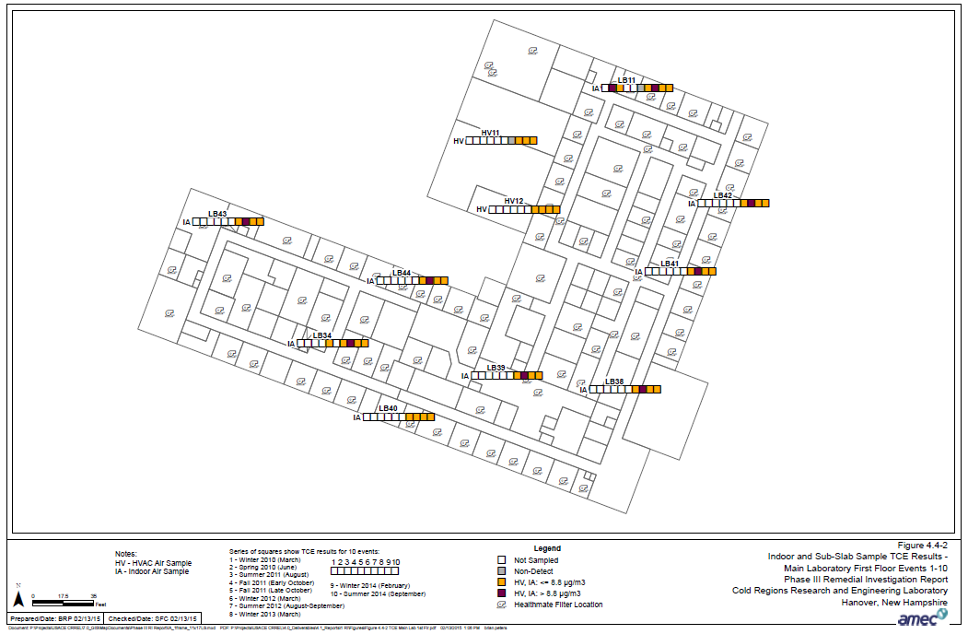
Indoor Air Figure Example

Slide 6
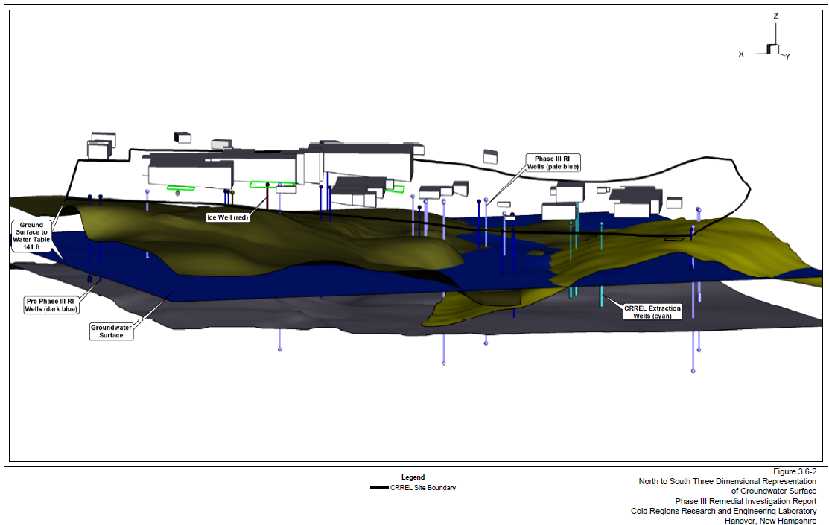
Example 3D

Slide 7
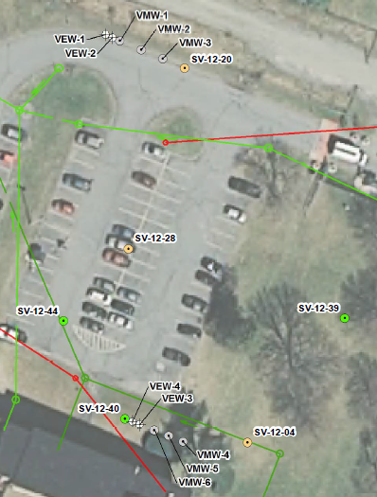
SVE Pilot Scope of Work
Completed 2 soil borings at VEW-1 and -3 (to 125 and 140 ft bgs, respectively)
Installed 2 deep and 2 shallow Vapor Extraction Wells (VEWs)
Installed 6 nested Vapor Monitoring Wells (VMWs)
  25, 75, 100 ft bgs
Work completed between Sept 22nd through Oct 1st

Slide 8
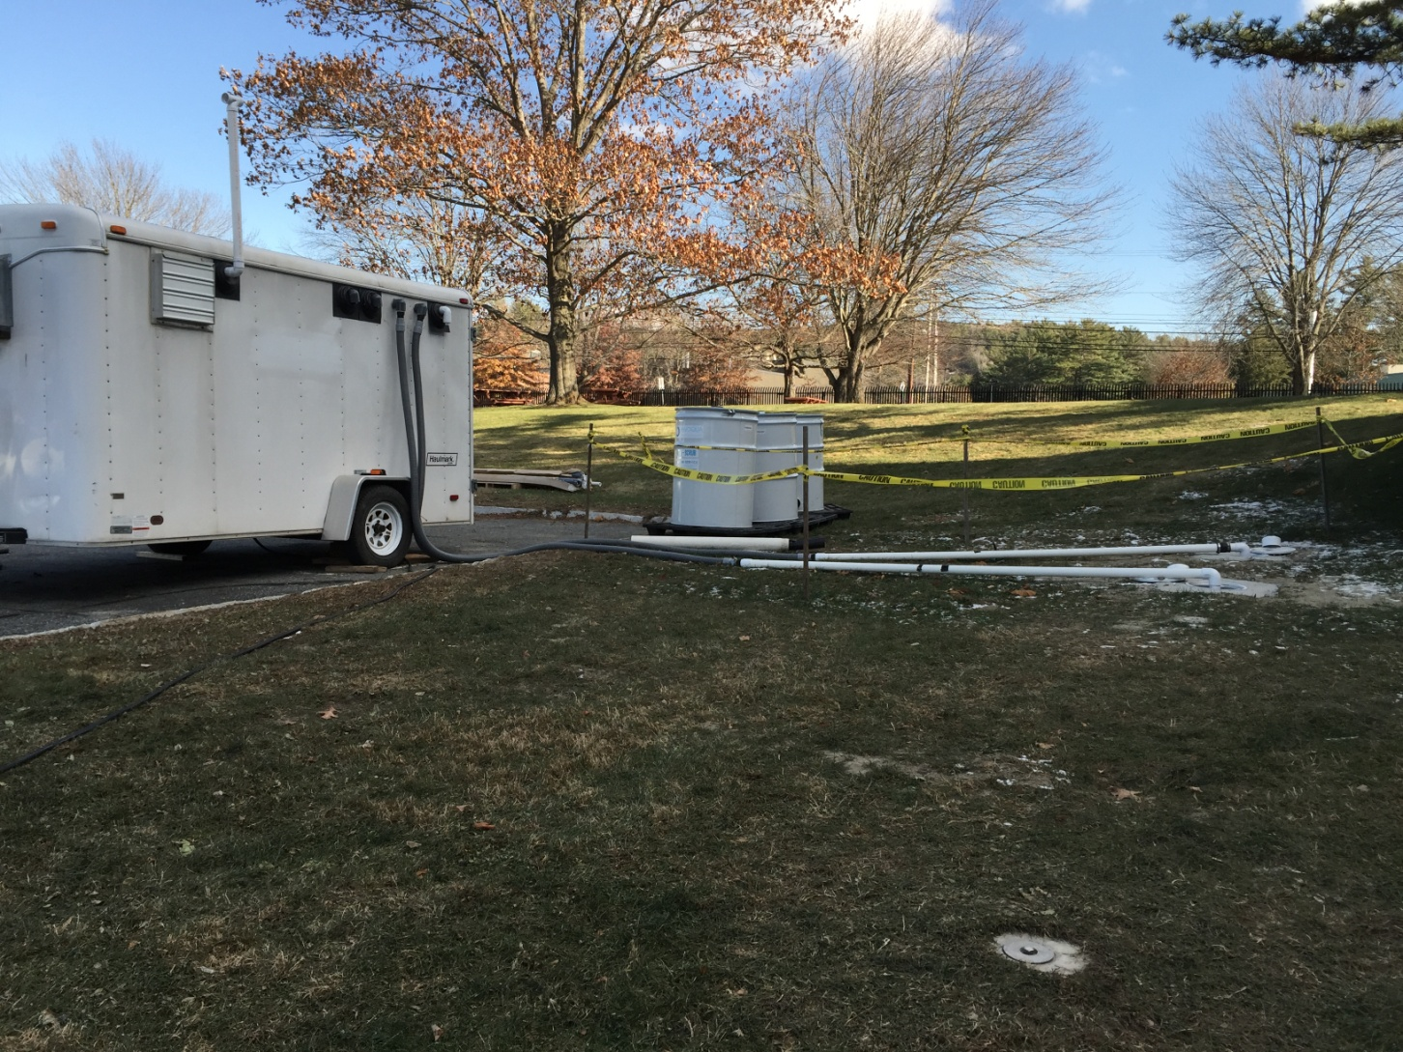
SVE System at AOC2

Slide 9
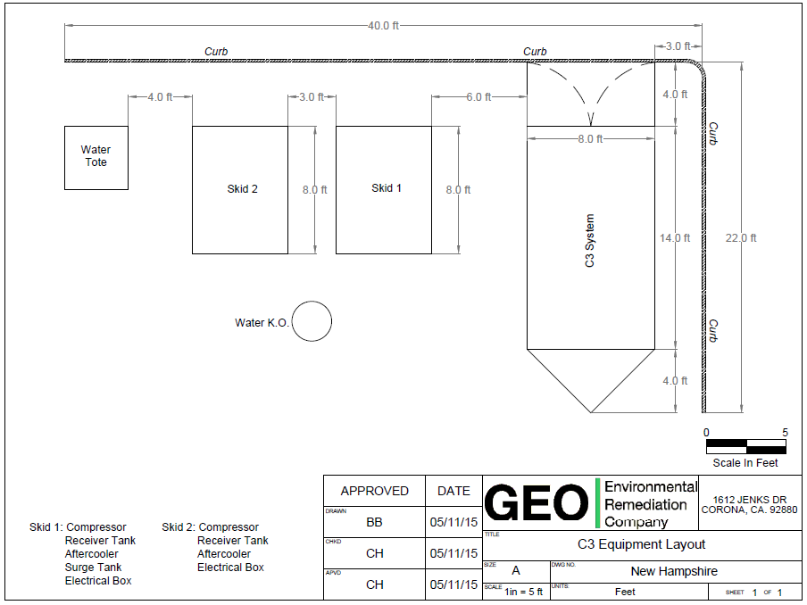

Slide 10
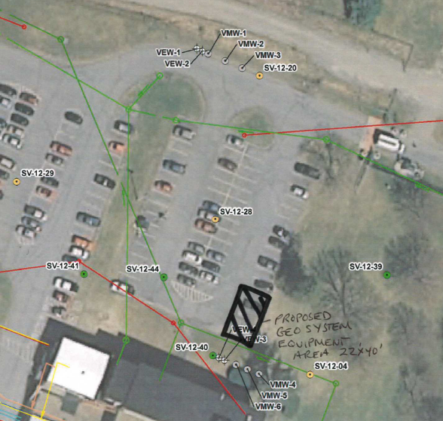
System Layout

Slide 11
SVE System Re-loaded

Slide 12
SVE System Re-loaded Schedule

Slide 13
On-Going and Completed Work Since Last Meeting in April
Remedial Investigation Work
Soil Vapor Extraction Pilot Study Planning and Contracting
Completing Draft of the Remedial Investigation Report
Vapor Intrusion Mitigation/Protection of Human Health Work
Continued regular monitoring of indoor air quality in Main Laboratory
Elevator Replacement Support
-73 Line Support
Conducted Richmond Middle School Indoor Air Sampling on April 13th

Slide 14
Upcoming Work
Remedial Investigation Work
Soil Vapor Extraction Pilot Study Execution
Completing Draft of the Remedial Investigation Report
Soil Vapor Sampling – ‘Synoptic’ Round (July/August)
Vapor Intrusion Mitigation/Protection of Human Health Work
Continued regular monitoring of indoor air quality in Main Laboratory
Tide Flex Roof Drain Install
Continue to Sleuth

